Slide 1


Walking the line between impartiality and participation
Sarah Butler
Kate Nichols, Jess Dart, Mark Boulet

Slide 2
Some Green Steps wisdom...
After requesting a some participation...."don't imagine you can just give the brief to the consultant and they will come back later with evaluation. You need to commit time and resources to this, otherwise the participatory approach is not as effective"

Slide 3

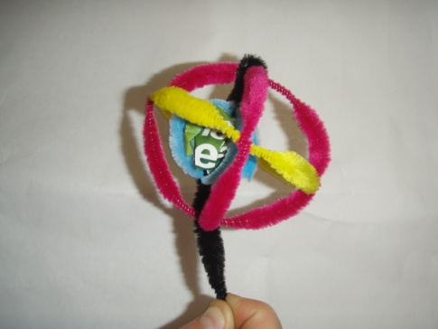

The story today
Plan
Planning workshop
Discover
Data collection
Report
Report

Slide 4


The beginning...
Academia...research, statistics....
Monitoring and evaluation consultancy
Core business has often involves participatory approaches
Strength in qualitative in data collection
Learning and development and capacity building

Slide 5
My gems....
Language
Understanding
Shared data analysis
Many brains make light work
Using and making time for the recommendations
Realising evaluation is a starting point

Slide 6
Balancing participation with independent evaluation
Often asked to do participatory evaluation
At same time independence is needed
  Often for funders
How do you balance the two?

Slide 7
Participation vs independence
Participatory | Independent
Values and beliefs of program/stakeholders Judgements made by those close to the program Decision making by those close to the program Can introduce bias in interpretation of data Lots of learning through participation in the process | Unbiased weight on different types of data Values of the evaluator only Unbiased comparison can be made between programs Recommendations provided by evaluators independent of program participants Data collection and analysis reliant on the skills and attention of evaluator Little involvement or learning by program participants

Slide 8

Theoretical underpinnings
Action research or action learning (e.g. Wadsworth 1993)

Slide 9

Theory continued...
Utilisation focused evaluation (Patton 2002)

Slide 10
Theory continued...
Empowerment evaluation (Wadersman et al. 2005)
Improvement
SHARED DECISION MAKING
Social justice
INCLUSION
Community knowledge
Stakeholder ownership

Slide 11
Theoretical underpinnings cont
Appreciative inquiry (Cooperrider & Whitney, 2005)

Slide 12


Independent (e.g. Scriven 1991, goal-free evaluation)
Contrast to participatory approaches
Independent of management
Benefits to end users or beneficiaries
Evaluator makes judgement based on evidence
Often suits funders

Slide 13
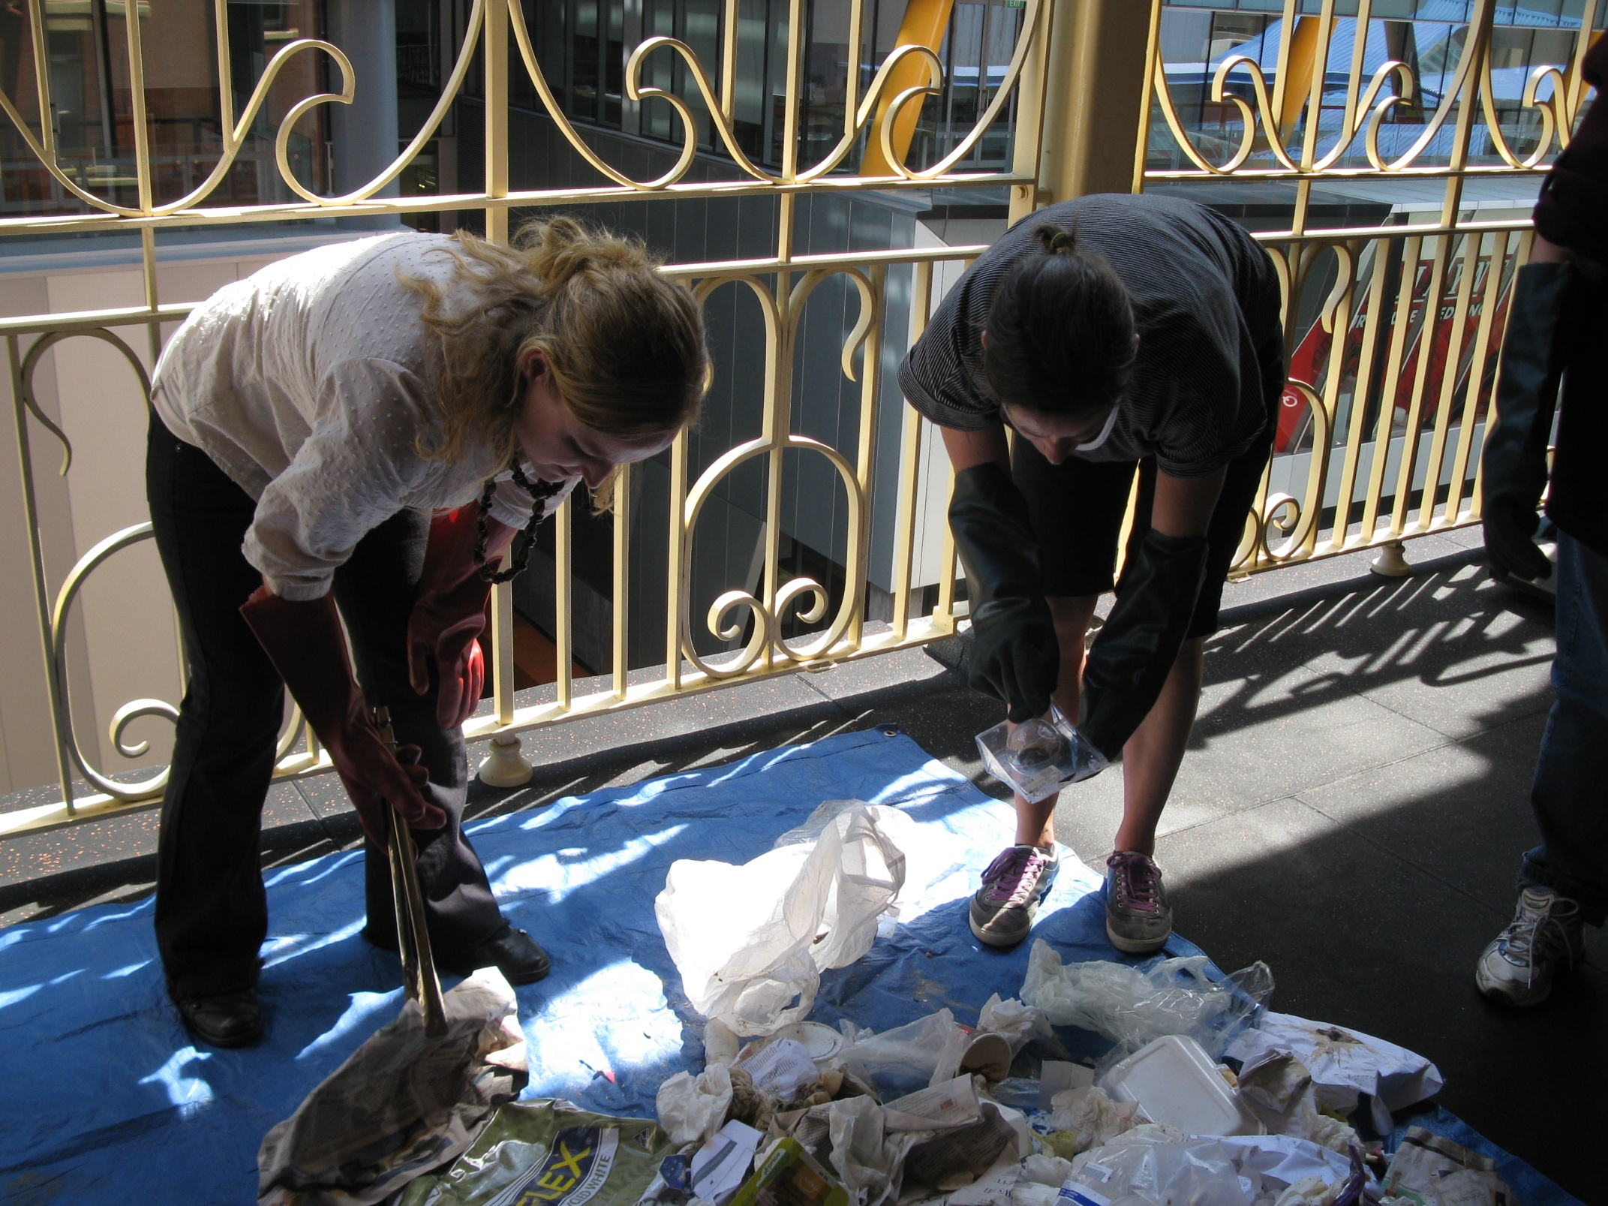
Case study: Green Steps
‘Hands-on’ education and leadership program
Empowerment of participants
Community feel and high level of participation
  Those who have participated have shaped the program

Slide 14
The situation
10 years had gone by
Funders were asking – What is the point? How are you going to support this program?
Need for independent data collection to see what had occurred and the impact
Explicit request for participation in the process

Slide 15
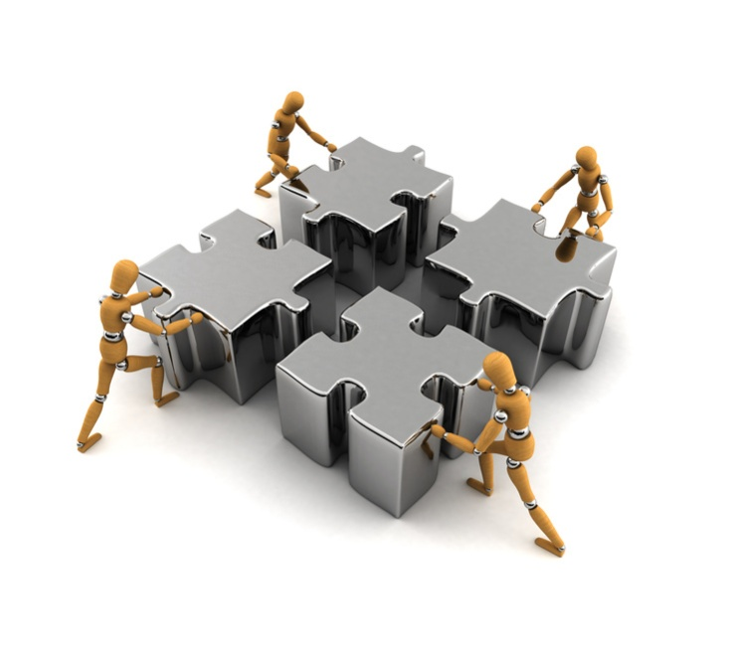
The culture

Slide 16
The process
Plan
Planning workshop
Discover
Data collection
Report
Report
3. Analyse
4. Report
5. Re-design
2. Discover
1. Plan

Slide 17
The process
Plan
Planning workshop
Discover
Data collection
Report
Report
Step in the evaluation | Level of participation (low, medium or high) | Who was involved e.g. who participated in the evaluation step
Step 1: Plan | high | Program staff, past participants, reference committee with consultants facilitating
Step 2: Discover | low | Consultants
Step 3: Analyse – preliminary data analysis | low | Consultants
Step 3: Analyse – summit workshop | high | Program staff, past participants, reference committee with consultants facilitating
Step 4: Report | low | Consultants
Step 5: Re-design | high | Program staff, reference committee with consultants facilitating

Slide 18
The process
Plan
Planning workshop
Discover
Data collection
Report
Report
Step in the evaluation | Level of participation (low, medium or high) | Who was involved e.g. who participated in the evaluation step
Step 1: Plan | high | Program staff, past participants, reference committee with consultants facilitating
Step 2: Discover | low | Consultants
Step 3: Analyse – preliminary data analysis | low | Consultants
Step 3: Analyse – summit workshop | high | Program staff, past participants, reference committee with Consultants facilitating
Step 4: Report | low | Consultants
Step 5: Re-design | high | Program staff, reference committee with Consultants facilitating

Slide 19
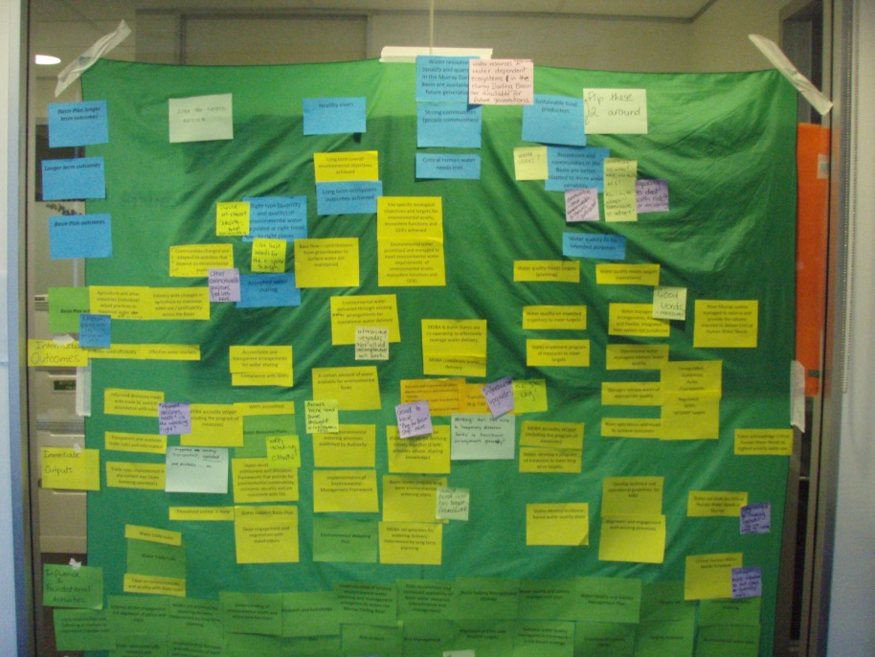
Steps...
Plan
Planning workshop
Discover
Data collection
Report
Report
Participatory planning

Slide 20
Independent data collection & analysis
In many ways this was also participatory....
  We talked with Green Steps all the time
  They knew where we were up to
  BUT
Internet survey – spread
In-depth semi-structured interviews – depth
Document review
Analysis – thematic and descriptive stats

Slide 21
Steps...
Plan
Planning workshop
Discover
Data collection
Report
Report
Summit workshop – participatory data analysis
Overarching results
Achievements
Issues/areas for improvement
Keep, drop, create
Recommendations

Slide 22


Steps...
Plan
Planning workshop
Discover
Data collection
Report
Report
Re-design/recommendations workshop

Slide 23
What happened
Used evaluation straight away to talk with funders
Used it to engage with senior executives
Used it to do new Green Steps activities
Design an M&E plan
It directly informed their 2 year business plan
  Many recommendations thrown away, modified or re-worded
As Mark said, “It has given them good grounding to move on from”

Slide 24
A little more Green Steps wisdom
“For a training program, we are often asked to demonstrate our outcomes and have struggled to do so with more traditional evaluation approaches. Participatory evaluation and collecting stories of change was the most effective approach. AND we got some nice quantitative outcomes.”

Slide 25
What we learnt - positives
You say ‘tomato’ I say ‘tomato’....
Culture of participation is invaluable – when it’s not there it’s really tough!
Summit or analysing data together was also a critical point & kept the evaluation fun
Bringing key executives into the re-design = evaluation directly informed business planning
It works!!

Slide 26
What we learnt
"don't imagine you can just give the brief to the consultant and they will come back later with evaluation. You need to commit time and resources to this, otherwise the participatory approach is not as effective”
It really isn’t for everyone
Even with the most participatory team it is tough
  dedication and passion for the program is important

Slide 27
What do I think....

Slide 28
Your questions....
http://www.monash.edu.au/research/sustainability-institute/green-steps/

